Slide 1
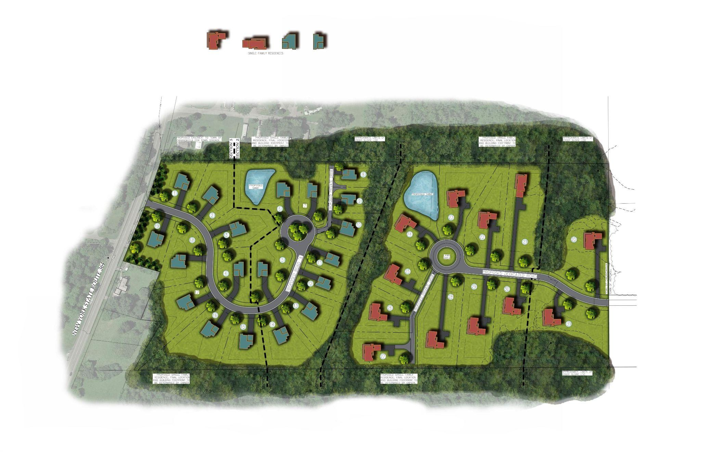
Sunset Ridge Estates/Lakewood Custom Homes
Preliminary Subdivision & Site Plan Review

Slide 2
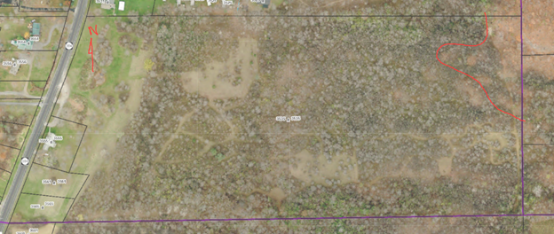
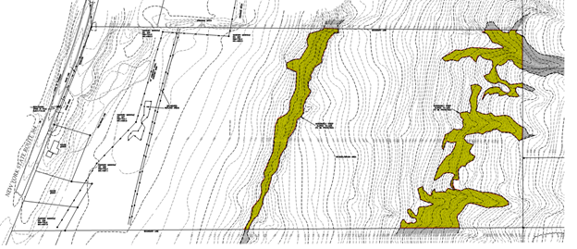
NRI & Open Space
Successional Northern Hardwood Forest (Not included in Town’s Strategic Forest Protection Area.)
Steep Slopes

Slide 3
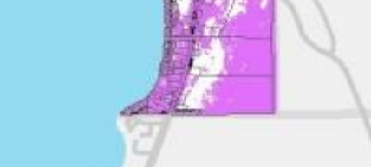
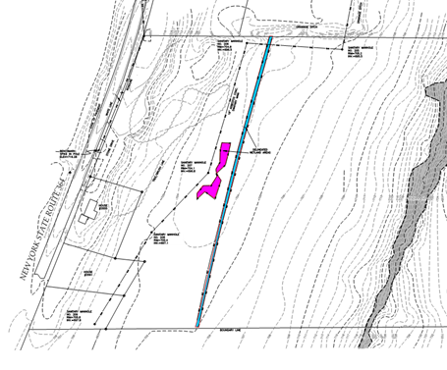
NRI & Open Space
3. Views from Canandaigua Lake
4. Small freshwater wetland

Slide 4
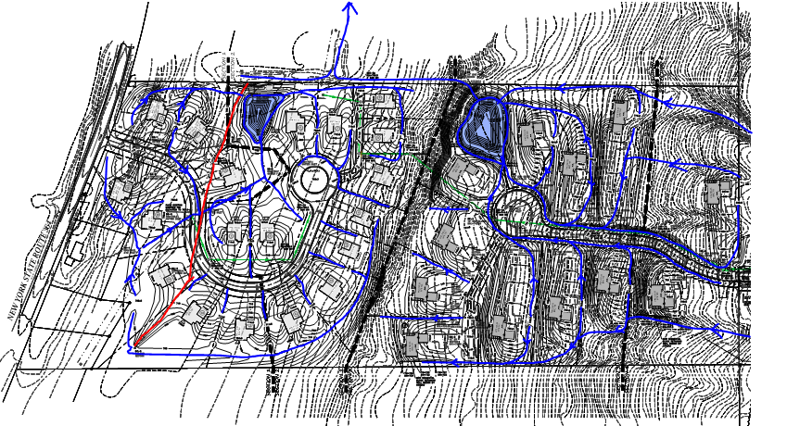
Stormwater
Proposed SWMF
Pond #1
Pond#2
Reduction from existing conditions
1yr. - 72.4%
10 yr. - 74.6%
100yr. - 40.3 %

Slide 5
Cross Section

Slide 6
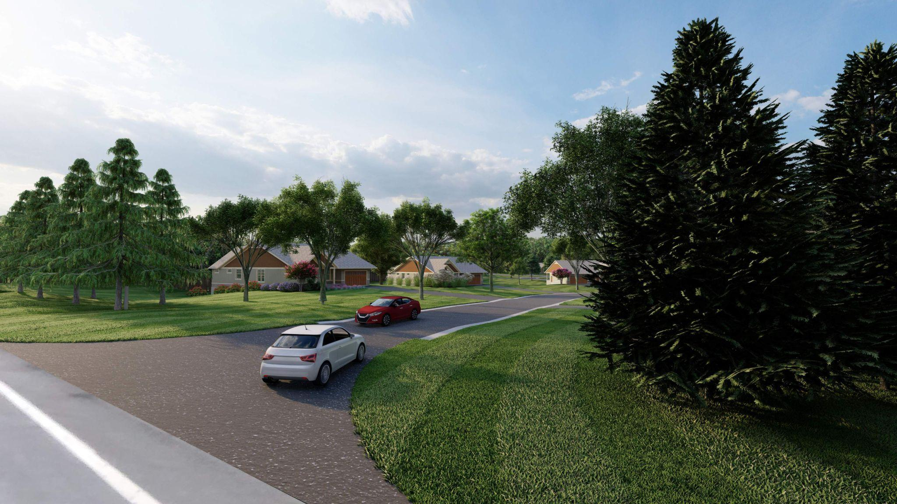
View driving north on NYS Route 364

Slide 7
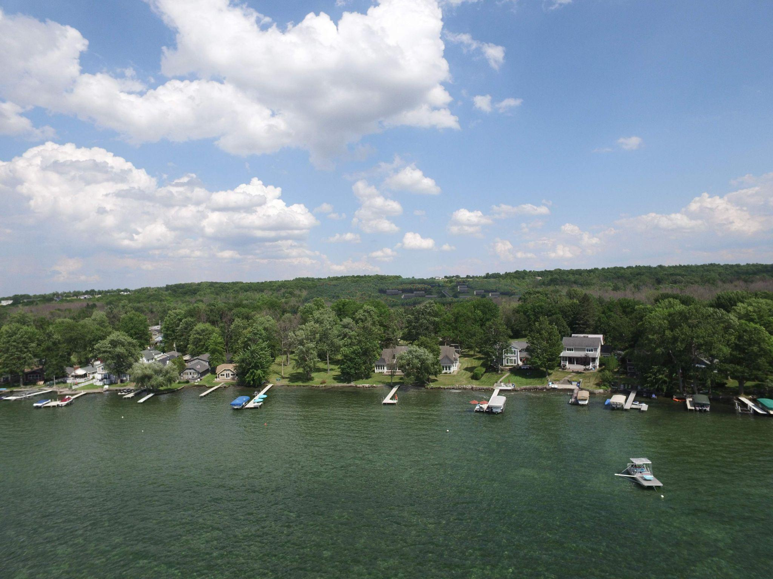
View from the lake

Slide 8
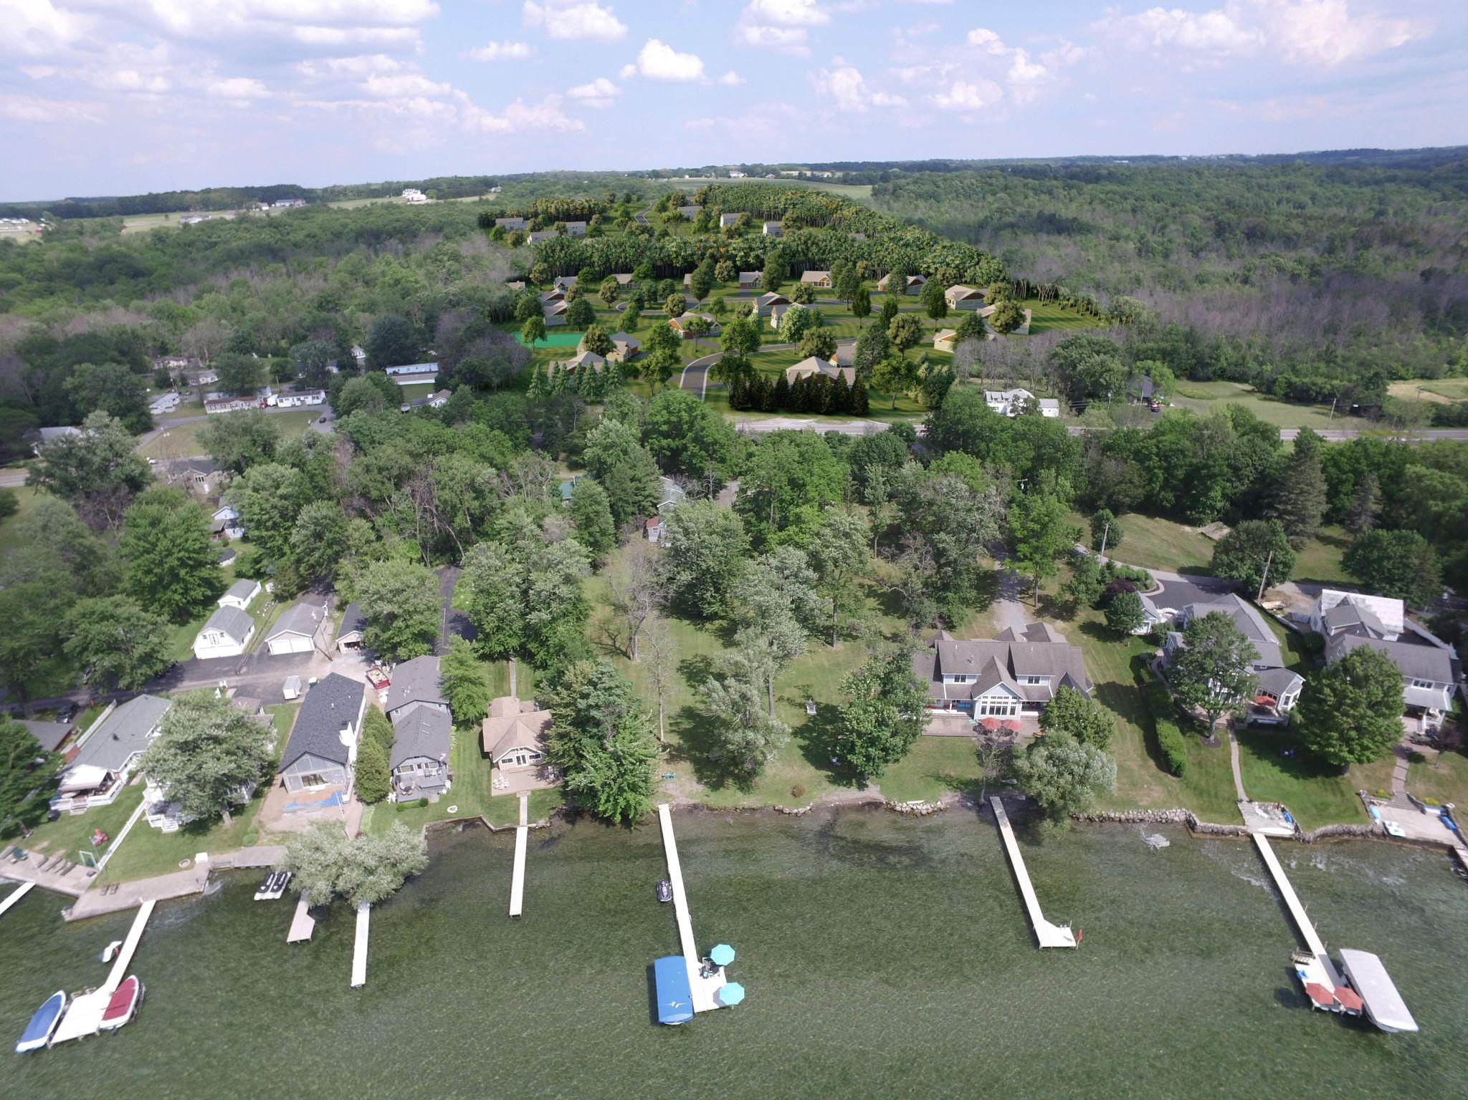
View from the lake

Slide 9
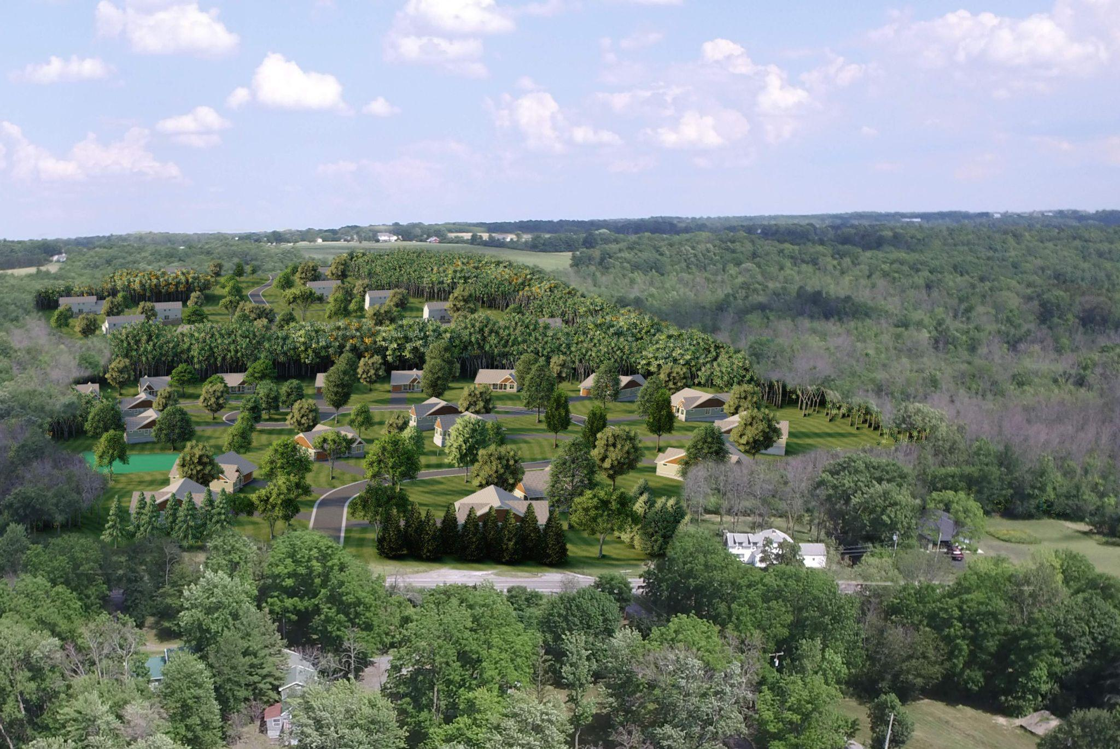
Close-up of view from the lake

