Slide 1
Ontario County Landfill
Do we keep it open as is, modify operations, or close it completely?
Notes:
This presentation was automatically generated by PowerPoint Copilot based on content found in this document: https://townofcanandaigua-my.sharepoint.com/personal/jsimpson_townofcanandaigua_org/Documents/Microsoft%20Copilot%20Chat%20Files/Landfill.pdf AI-generated content may be incorrect.

Slide 2
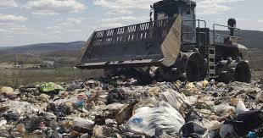
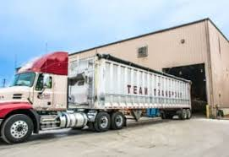
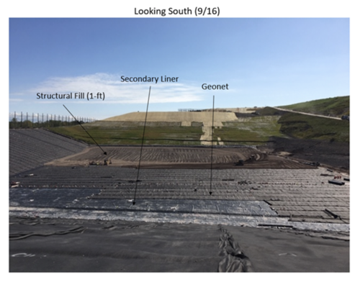
Odor and Air/Heavy Truck Traffic/Potential Contamination
Odor and Air Issues
Recent control measures have led to a reduction in number of odor complaints
There are continued concerns for nearby residents and businesses
Particulate matter (PM) from diesel engines of transfer trailers
Greenhouse gases (GHGs) such as methane from decomposing waste
Truck Traffic
Significant Heavy Truck Traffic, 75 to 80 transfer trailers daily
Trucks carry waste through the Town of Seneca
Heavy trucks generate considerable noise and air emissions
Trucks contribute to air pollution
Potential damage to roads from heavy traffic
Potential Contamination
Landfill Liner Systems are required to prevent contamination
Groundwater Monitoring is required to be implemented to detect contamination
No system is 100% foolproof
Notes:
The landfill has faced odor control challenges, particularly with hydrogen sulfide emissions from degrading gypsum drywall. Recent measures have reduced complaints, but potential issues remain for nearby residents and businesses. Original Content: 1. Odor: The landfill has experienced challenges with odor control over the years, particularly with hydrogen sulfide (H2S) emissions from the degradation of gypsum drywall. Although recent measures have reduced the number of odor complaints, the potential for odor issues remains, especially for nearby residents and businesses.

Slide 3
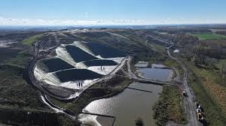
Keep It Open, Expand and Keep 100% Fill Rate
POSITIVE: Cost for residential households would increase the least by approximately 2.4% to 7.5%
Local governments would continue to see some revenue from the landfill
NEGATIVE: Landfill would continue to see significant growth
Town of Seneca Voted 5-0 to close the landfill
Landfill's elevation makes it a noticeable feature in the landscape
Presence of a large regional landfill can lead to a loss of property values
Environmental impacts associated with the landfill contribute to this loss
Ontario County Landfill
Expand ….
Vertical Expansion?
Horizontal Expansion?
Notes:
If the landfill continues to accept the same amount of waste, residential household costs will increase by 2.4% to 7.5%, depending on current subscription rates. Original Content: 1. Landfill Expansion: ○ 100% of Current Fill Rate: If the landfill continues to accept the same amount of waste as it currently does, the cost for residential households will increase by approximately 2.4% to 7.5%, depending on the current subscription rates[1].

Slide 4
Keep It Open and Reduce The Fill Rate
Cost Increase by Waste Management Option
Option | Cost Increase (%)
50% of Current Fill Rate | 4.4% to 10.1%
County Waste Only | 7.5% to 20.9%
NEW Transfer Station to Seneca Meadows | 11.1% to 16.4%
NEW Transfer Station to High Acres | 8.4% to 10.1%
Direct Haul to Seneca Meadows | 16.4% to 68.2%
Direct Haul to High Acres | 8.1% to 19.4%
Direct Haul to Mill Seat | 10.1% to 20.9%
50% of Current Fill Rate = Slower Growth
Reducing waste accepted by half could increase costs by 4.4% to 10.1%
County Waste Only
Accepting only Ontario County waste increases residential costs by 7.5% to 20.9%
Build a NEW County Commercial Transfer Station ( many towns currently have transfer stations)
Transfer to Seneca Meadows increases costs by 11.1% to 16.4%
Transfer to High Acres increases costs by 8.4% to 10.1%
Waste Export by Direct Haul
Direct Haul to Seneca Meadows increases costs by 16.4% to 68.2%
Direct Haul to High Acres increases costs by 8.1% to 19.4%
Direct Haul to Mill Seat increases costs by 10.1% to 20.9%
Notes:
Reducing waste by half increases costs by 4.4% to 10.1%. Accepting only Ontario County waste raises residential costs by 7.5% to 20.9%. Transferring to Seneca Meadows or High Acres increases costs by 11.1% to 16.4% and 8.4% to 10.1%, respectively. Direct hauling to various sites significantly raises costs. Original Content: ○ 50% of Current Fill Rate: Reducing the amount of waste accepted by half will result in a cost increase of about 4.4% to 10.1%[1]. ○ County Waste Only: If the landfill only accepts waste generated within Ontario County, the cost for residential households will increase by approximately 7.5% to 20.9%[1]. 2. Waste Export with Commercial Transfer Station: ○ Transfer to Seneca Meadows: This option will increase costs by about 11.1% to 16.4%[1]. ○ Transfer to High Acres: Costs will rise by approximately 8.4% to 10.1%[1]. 3. Waste Export by Direct Haul: ○ Direct Haul to Seneca Meadows: This will increase costs by about 16.4% to 68.2%[1]. ○ Direct Haul to High Acres: Costs will rise by approximately 8.1% to 19.4%[1]. ○ Direct Haul to Mill Seat: This will result in a cost increase of about 10.1% to 20.9%[1].

Slide 5
Landfills in Relation to Ontario County

Slide 6
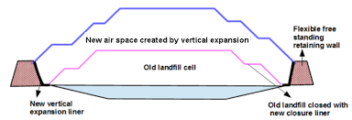
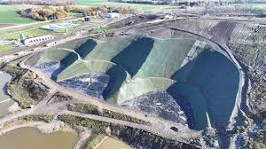
Vertical Expansion
Lateral Expansion
Pros
Maximizes Space
Utilizes the current landfill footprint
Minimizes land use
Lower Costs
Generally less expensive than lateral expansion
Doesn't require new land acquisition
May face fewer regulatory hurdles compared to new landfills
Cons
Structural Challenges
Requires careful engineering to ensure stability
Limited Capacity Increase
May not provide as much additional capacity as a new landfill
Potential for increased odor and visual impact
Pros
Increased Capacity
Provides significant additional space for waste disposal
Long-Term Solution
Extends the landfill's operational life considerably
Cons
Requires purchasing additional land
Can be costly and contentious
Permitting and construction costs
Greater potential for environmental disruption
Greater Regulatory challenges
Vertical Expansion
Lateral Expansion
Notes:
This section explores the potential for expanding the existing landfill either vertically or laterally. Vertical expansion maximizes existing space and is generally less expensive as it doesn't require new land acquisition. Original Content: This section examines the potential for expanding the existing landfill vertically or laterally to extend its capacity. Vertical Expansion Pros: ● Maximizes Existing Space: Utilizes the current landfill footprint, minimizing land use. ● Lower Costs: Generally less expensive than lateral expansion as it doesn't require new land acquisition.

Slide 7
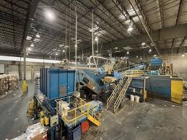
Waste Diversion?
Maintaining Status Quo
Waste Diversion
Not closing the landfill may reduce the incentive to develop alternative waste management solutions
Recycling and composting are more environmentally friendly alternatives
Environmental Challenges
Continued operation of the landfill poses several environmental challenges (outlined earlier) that would need to be taken into consideration
Need to manage these challenges carefully to minimize negative impacts
Ontario County Recycling Facility (MRF)
Could continue IF landfill closes.
Notes:
The landfill's continued operation poses environmental challenges and may reduce incentives for recycling and composting. These alternatives are more eco-friendly. Financial impacts on households are detailed in the OntarioCoLandfillReportFINAL09-16-2024. Original Content: 7. Waste Diversion: Not closing the landfill may reduce the incentive to develop alternative waste management solutions, such as recycling and composting, which are more environmentally friendly. Overall, while the landfill provides a necessary waste disposal service, its continued operation poses several environmental challenges that need to be managed carefully to minimize negative impacts on the local community and environment. If you have any more questions or need further details, feel free to ask! The financial impacts of the landfill alternatives on residential households in Ontario County are detailed in the OntarioCoLandfillReportFINAL09-16-2024. Here are the key points:

Slide 8
Waste-to-Energy Facility
PROs
Converts waste into energy
Reduces reliance on fossil fuels
Significantly reduces waste volume
Reduces methane emissions compared to landfilling
CONs
Regulatory Constraints
Strict regulations limit the siting of new WTE facilities.
High Capital Costs
Expensive to build and operate.
$41-$169MM, some closer to $1B to construct
$102$ - 680K, per ton fees, $30 - $30 MM annual operating costs
Public Opposition
Often faces strong community resistance due to perceived health risks and environmental impact.
Waste To Energy Simulation Video
Notes:
Waste-to-energy facilities offer several benefits, including converting waste into energy, reducing waste volume, and lowering methane emissions compared to landfilling. Original Content: County, including waste-to-energy (WTE) facilities, new landfills, and organics processing facilities. Waste-to-Energy Facility Pros: ● Energy Recovery: Converts waste into energy, reducing reliance on fossil fuels. ● Volume Reduction: Significantly reduces the volume of waste needing disposal. ● Greenhouse Gas Reduction: Can reduce methane emissions compared to landfilling.

Slide 9
New Landfill Development
Pros
Provides long-term waste disposal solution
Allows local control over waste management
Revenue from tipping fees
Cons
Regulatory and Siting Challenges
Public opposition
Difficult to find suitable locations due to environmental and community concerns
High costs for land acquisition, permitting, and construction
Potential risks to groundwater and air quality
Costs
Construction $50 - $100 MM
Operational $5 - $10 MM
Notes:
New landfill development faces public opposition due to health and environmental concerns. However, it provides a long-term waste disposal solution and allows local control over waste management. Original Content: ● Public Opposition: Often faces strong community resistance due to perceived health risks and environmental impact. New Landfill Development Pros: ● Waste Disposal Capacity: Provides a long-term solution for waste disposal. ● Local Control: Allows the county to manage its waste independently.

Slide 10
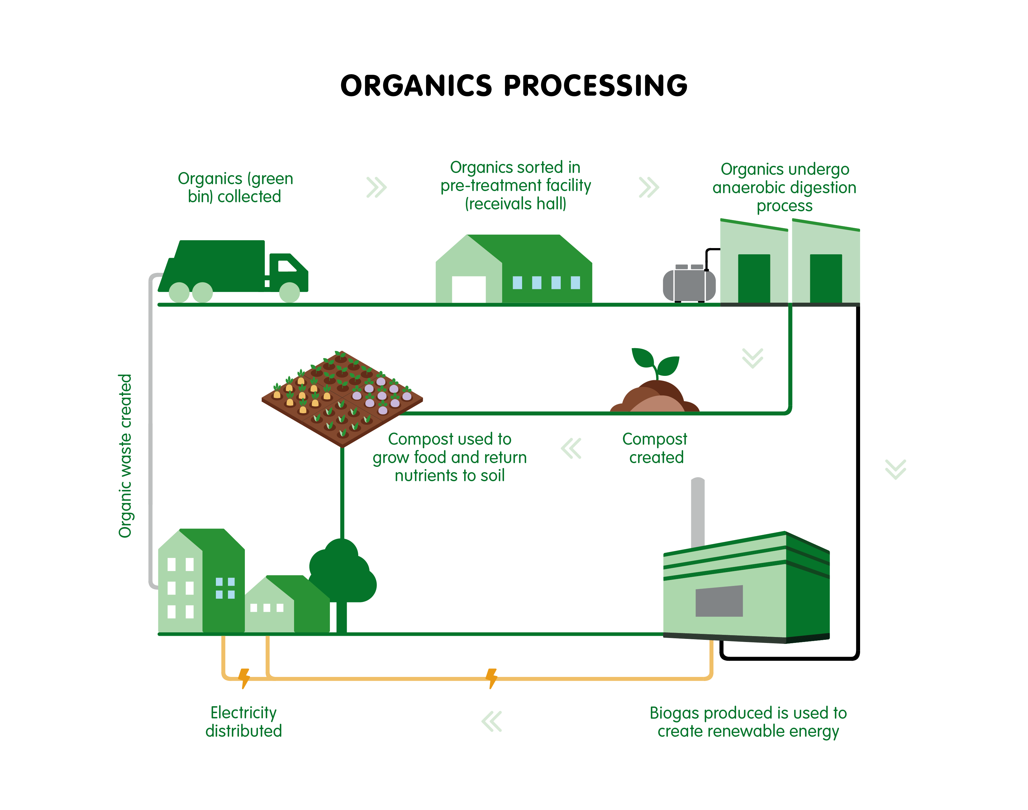
Organics Processing Facilities
Pros
Reduces the amount of waste sent to landfills
Produces valuable compost or biogas
Reduces greenhouse gas emissions and improves soil health
Potential Revenue
Potential revenue from sale of compost or biogas
Cons
Collection and Processing Costs
Requires investment in infrastructure and collection systems
Development of a centralized anaerobic digester estimated at $10 million for a 10,000 ton/year facility
Annual operating costs projected to be around $1 million to $2 million
Needs a market for the end products (compost or biogas)
Managing contamination and ensuring consistent feedstock quality
Notes:
Organics processing facilities have high costs due to land acquisition, permitting, and construction. They pose potential environmental risks to groundwater and air quality. However, they divert waste from landfills, recover resources by producing compost or biogas, and provide environmental benefits by reducing greenhouse gas emissions and improving soil health. Original Content: ● High Costs: Significant expenses for land acquisition, permitting, and construction. ● Environmental Impact: Potential risks to groundwater and air quality. Organics Processing Facilities Pros: ● Waste Diversion: Reduces the amount of waste sent to landfills. ● Resource Recovery: Produces valuable compost or biogas. ● Environmental Benefits: Reduces greenhouse gas emissions and improves soil health.

Slide 11
The Town of Canandaigua has one of the busiest transfer stations in the county.
We have the largest recycling and food waste diversion numbers in the county. This is Good!
The is what the town pays annually at the landfill.
Increase for people who hire a trash hauling company
This is the estimated cost increase for each scenario, expand or close.
Seneca Meadows
High Acres
Mill Seat

Slide 12
Next Steps
Close?
We have 4 years and reserve funds set aside to construct alternative
Closing and walking away is not an option.
If it closes?
Decision on building a County Transfer Station vs. Direct (Municipality or Private Provider Haul)?
There will be increased costs for residents
Is there a viable alternative to traditional landfill?
Where would it go?
Timeline
County Board of Supervisors will look to have a preliminary decision at the December 5th 2024 meeting.
Access the full landfill study here
Please send your comments to jsimpson@townofcanandaigua.org
Remain Open at 100%?
We must start the re-permitting process now
Could take years
How does it expand and where?
Lowest cost to residents
Remain Open at 50% or Just For County Residents?
Similar re-permitting to 100% option
How does it expand and where?
Would need to find an operator or have county operated facility
Moderate cost increase to residents

Slide 13
Final Thoughts
After 2028 how we handle our trash will change no matter what decision is made by the Board of Supervisors.
If we close the landfill, we will be transporting our garbage long-distances to other municipalities.
Whether it stays open or closes, costs will go up.
Most of our surrounding towns charge for the use of their transfer stations.
As an annual fee, a per bag fee, or a per pound fee.
There has never been any charge for use of the transfer station in the Town of Canandaigua, except for things like construction debris, large items, tires … this might need to change in the future.
A decision to close or stay open will be the start of a multi-year transition process.
Diversion and recycling efforts will be more important than ever.
In the event that we need to build a new transfer station in the town, the Town Board has set aside almost $800,000 in a solid waste management reserve fund.

